Slide 1

My Olympic Dream
Angie, Ryan, Tristan, & Ty

Slide 2

Background
Basis
2020 Tokyo Olympic games
Apparent lack of Olympic research, especially prediction
Goals
Breakdown of men and women athletes by Olympic games
Change in sporting events and athletes since the start of the Olympics
Are height and weight predictive of success?
Specifically with respect to men’s 100 yard dash
Does GDP predict success?
Is there a host country advantage?

Slide 3

Data Munging
Dataset obtained from Kaggle
Web-scraped data (https://www.kaggle.com/heesoo37/120-years-of-olympic-history-athletes-and-results)
Post WWII data only (1948 and beyond)
Broken down by summer and winter games
GDP data taken from World Bank 2000 to 2018 (https://data.worldbank.org/indicator/NY.GDP.MKTP.CD)

Slide 4

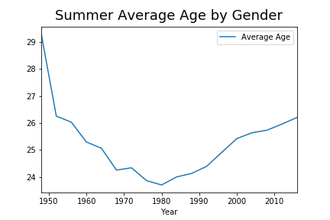
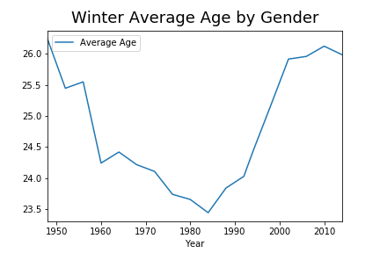
Age Analysis

Slide 5

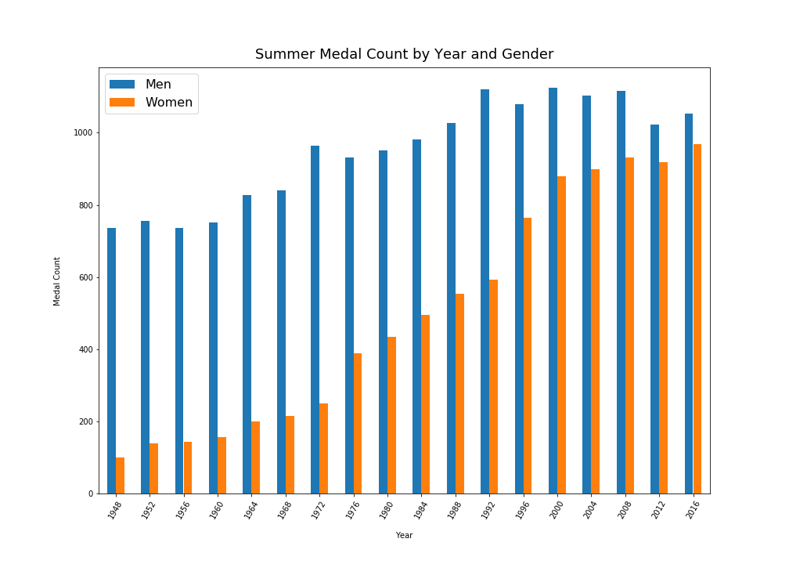
Gender Analysis

Slide 6

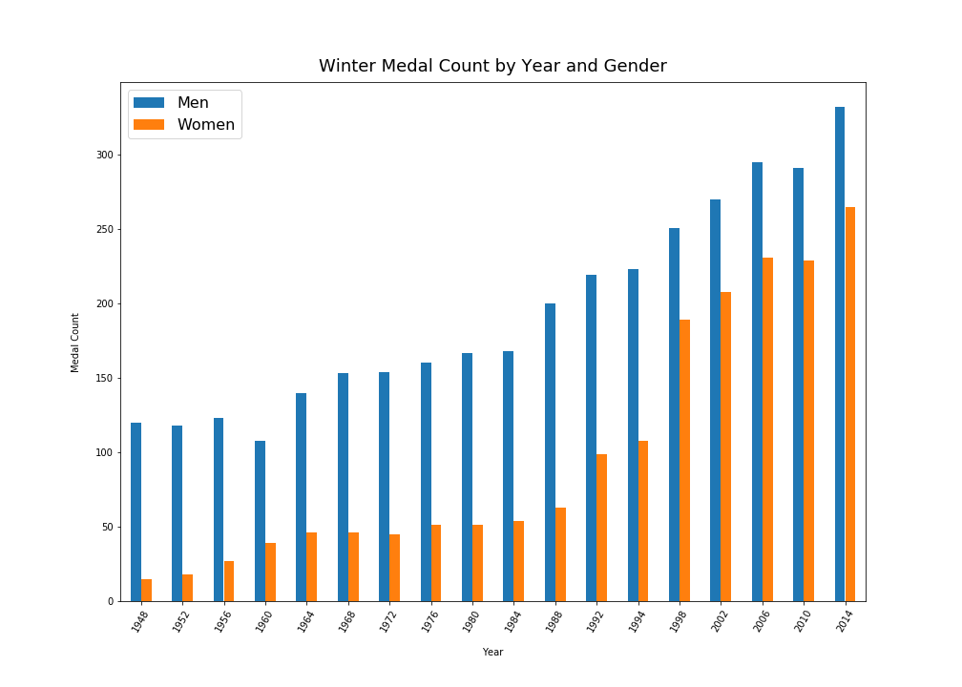
Gender Analysis

Slide 7

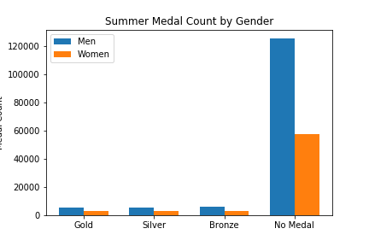
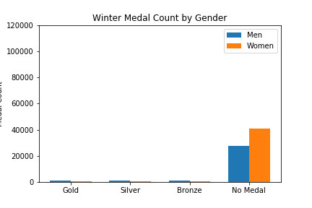
Gender Analysis
Medal Count
Medal Count

Slide 8

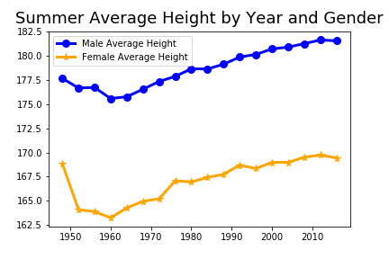
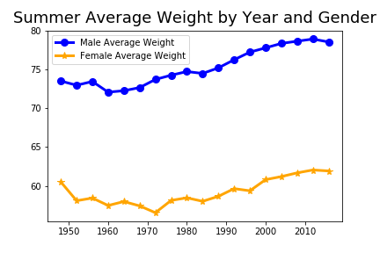
Gender Analysis
Kilograms
Centimeters

Slide 9

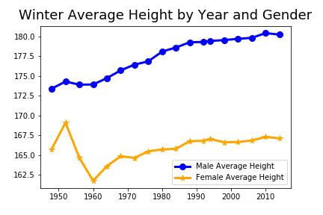
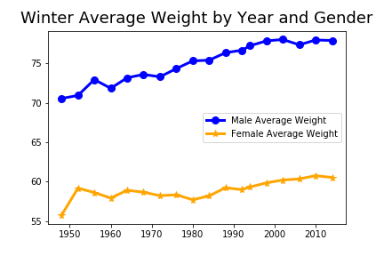
Gender Analysis
Kilograms
Centimeters

Slide 10

Sport and Participation Growth

Slide 11

Country Analysis

Slide 12

Individual Athlete Analysis

Slide 13

Historical Analysis

Slide 14
GDP versus Medal Count…is there a correlation?

Slide 15
The process:
Sourced GDP data from the World Bank
Data munging – how did we handle missing data?
Merging clean GDP dataset to the Olympic dataset
Performed regression analysis
This is what we found…

Slide 16
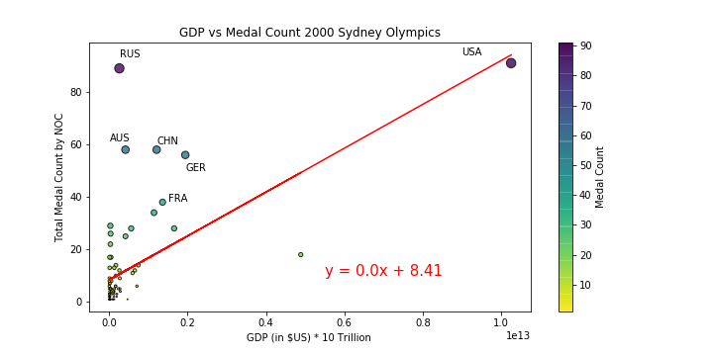
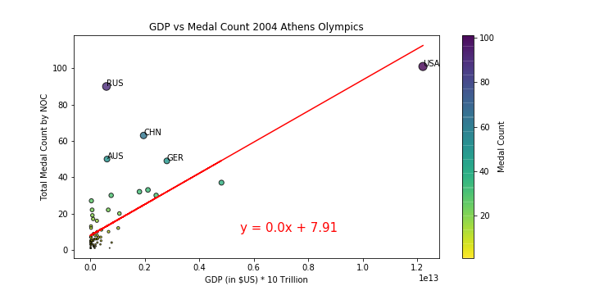
2000 Sydney Olympics (rvalue = 0.60)
2004 Athens Olympics (rvalue = 0.72)

Slide 17
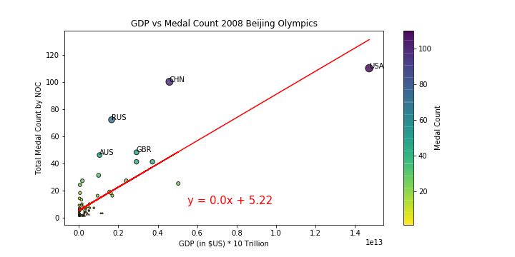
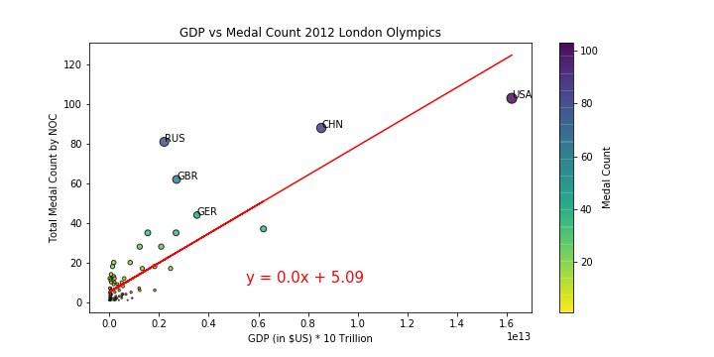
2008 Beijing Olympics (rvalue = .80)
2012 London Olympics (rvalue = 0.83)

Slide 18
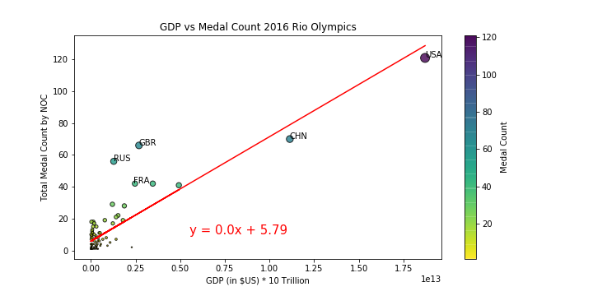
2016 Rio Olympics (rvalue = 0.86)

Slide 19

GDP
r² of GDP Regressed on Medal Count by Games
Games | r²
2000 Sydney | .36
2004 Athens | .52
2008 Beijing | .65
2012 London | .69
2016 Rio de Janeiro | .75

Slide 20
Hosting versus Medal Count…is there a correlation?

Slide 21

Hosting
Filter the data for post WWII
Divide the medal results into summer and winter games
Concentrate on the summer games in anticipation of Tokyo 2020
Find data for host countries and years: https://www.downloadexcelfiles.com/wo_en/download-excel-file-list-olympic-host-cities#.XjW0N2hKhPY
Verify the data with Wikipedia

Slide 22

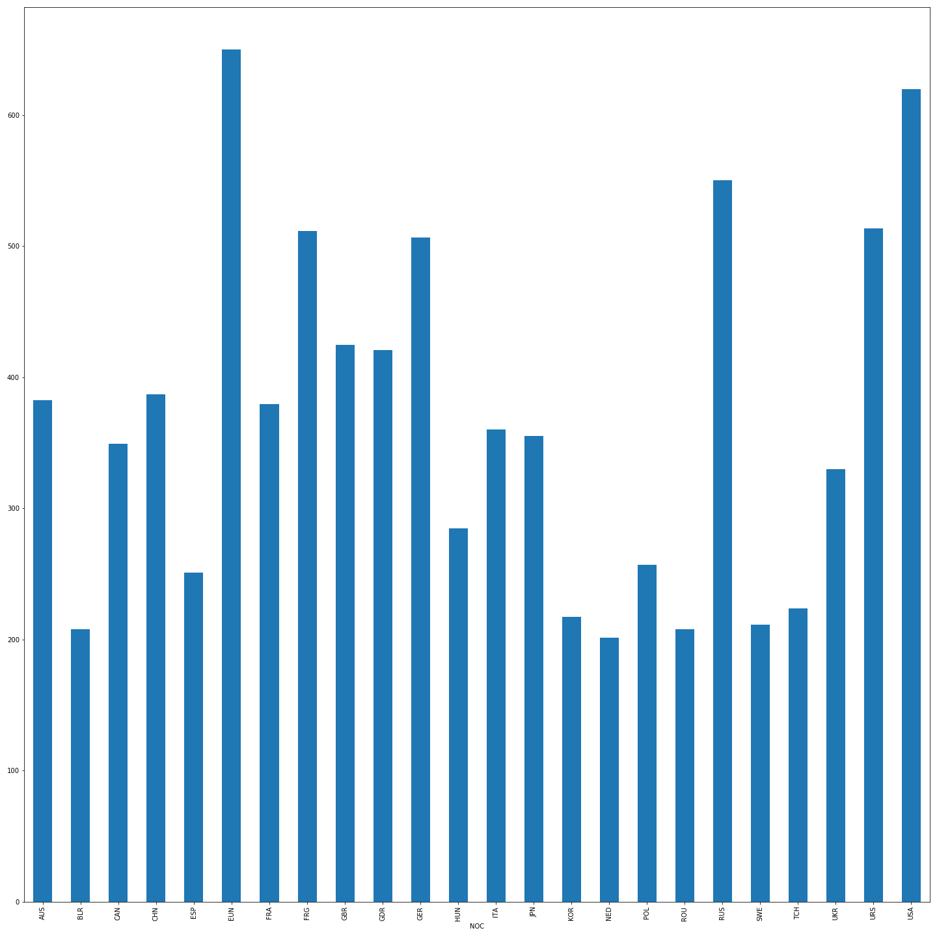
Hosting
A question occurs: what countries field the largest teams?
Nothing too deep here, what else can we uncover?

Slide 23

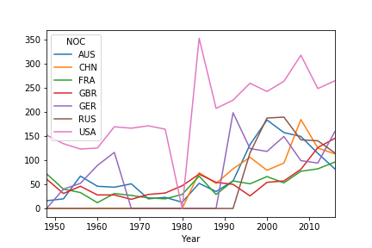
Hosting
A question occurs: can we predict which countries will lead in the medal count in 2020?
This leads us to a deeper question…

Slide 24
Hosting
A question occurs: does hosting the games lead to an increase in medal count?
A problem creeps up: the distribution of medals does not appear to be normal (backed up by SciPy’s normaltest()).
The solution: take the difference in a country’s medal count between the years when a country hosted the summer games and the average of the summer games before and after.
Apply the Wilcoxon test to this new dataset (SciPy’s wilcoxon())
According to this test, we reject the null hypothesis.

Slide 25

Extra

Slide 26

Extra

Slide 27

Extra

Slide 28

Extra

Slide 29

Extra

Slide 30

Extra

Slide 31

Extra

Slide 32

Extra

Slide 33

Extra

Slide 34

Extra

Slide 35

Extra

Slide 36

Post Mortem
Problems
Difficulty locating API
Coding is hard
Further Questions
Identify additional factors that could be predictive of success
Professional sports leagues
Performance enhancing drugs
Country size

Slide 37

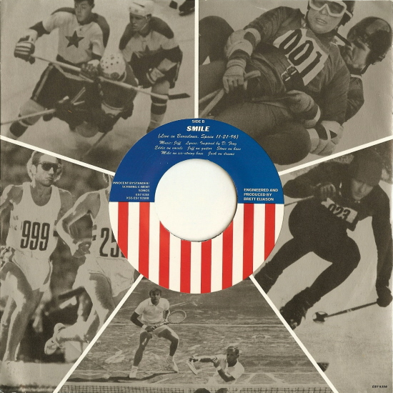

My Olympic Dream Performed by Pearl Jam ( 1996 fan club single) Written by Pearl Jam Sound Engineer Nick Didia
Questions

Slide 38
My Olympic Dream Performed by Pearl Jam ( 1996 fan club single) Written by Pearl Jam Sound Engineer Nick Didia
Olympic dream, Olympic dream If I could reach to the sky and touch it for my country Get some on my finger and take in its smell The smell of victory, land of the free, Olympic dream Olympic Dream Olympic theme My Olympic dream My promotion scheme How hard can it be How high can I jump How high can I throw How high can I run (I’m running very fast) How long can I hold my breath and stay underwater And wave my legs around in perfect unison with my partner who doesn’t really understand me And my Olympic dream, my Olympic dream
I’ll be like Dwight Stones I’ll be like Bruce Jenner I’ll be like that girl who trained all her life as a distance runner And then tripped with a quarter mile to go But I . . . I will get up and I will run I will run with the Georgia peach breeze and I . . .
I will win I will win my . . . my Olympic dream My Olympic dream The gold’s just not good enough And I don’t even think of bronze I’m living my life for Olympic Platinum I’ll sing like Whitney (sing like Whitney) My Olympic dream

Slide 39
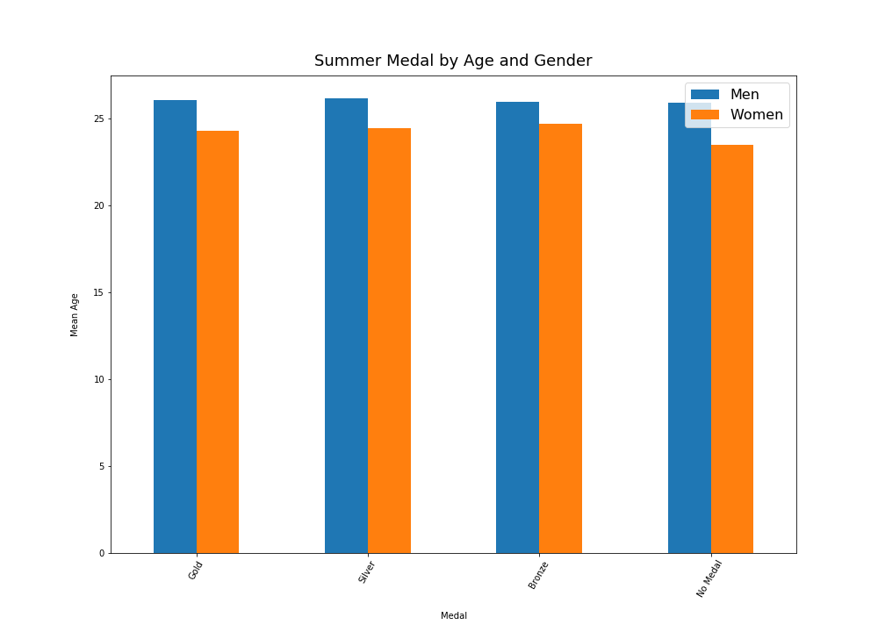
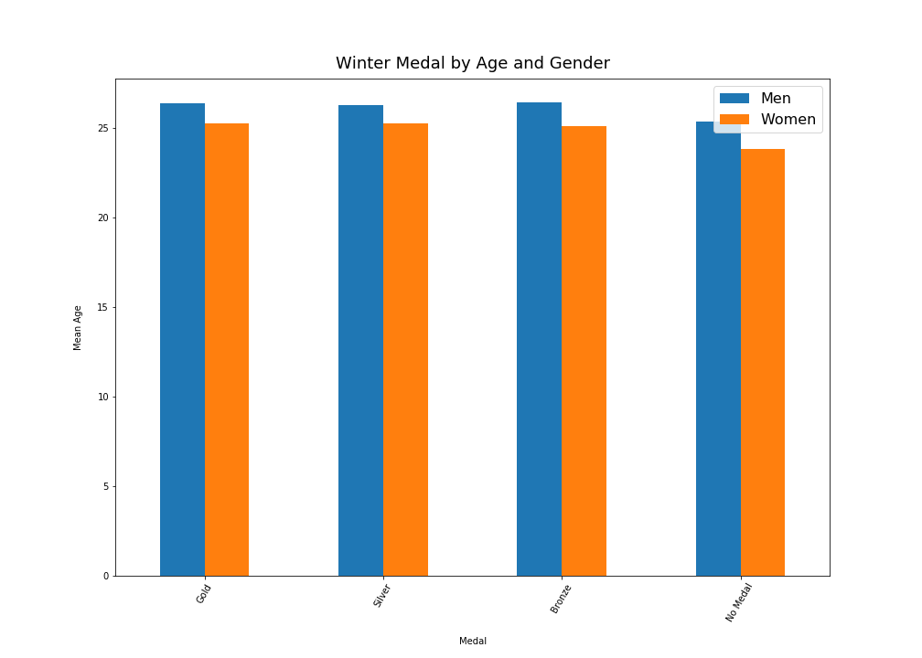
Age Analysis

Slide 40
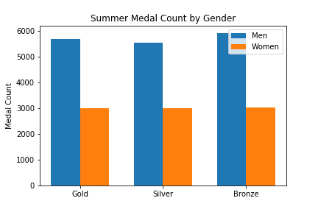
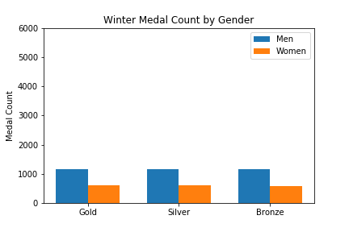
Gender Analysis

